Slide 1



Is delay always
harmful to precision?
Nikolett Német*, Scott Parkins
University of Auckland,
The Dodd-Walls Centre for Photonic and Quantum Technologies
Matariki Workshop on Quantum Science 20/03/16
*n.nemet@auckland.ac.nz

Slide 2
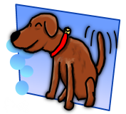
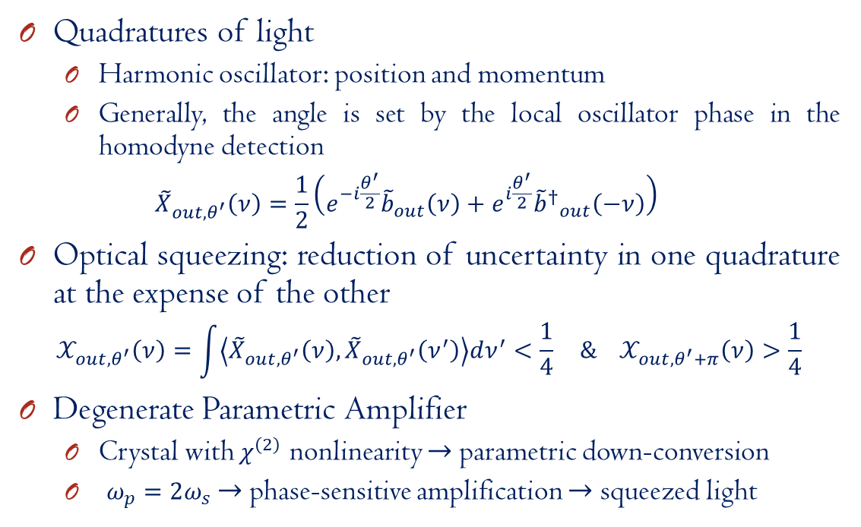
Optical squeezing & DPA
Quadratures of light
Harmonic oscillator: position and momentum
Generally, the angle is set by the local oscillator phase in the homodyne detection
$${\tilde{X}}_{out,θ^{′}}\left(ν\right)=\frac{1}{2}\left(e^{−i\frac{θ^{′}}{2}}{\tilde{b}}_{out}\left(ν\right)+e^{i\frac{θ^{′}}{2}}{{\tilde{b}}^{†}}_{out}^{}\left(−ν\right)\right)$$
Optical squeezing: reduction of uncertainty in one quadrature at the expense of the other
$$𝒳_{out,θ^{′}}\left(ν\right)=\int{\left\langle {\tilde{X}}_{out,θ^{′}}\left(ν\right),{\tilde{X}}_{out,θ^{′}}\left(ν^{′}\right)\right\rangle dν^{′}<\frac{1}{4}} \& 𝒳_{out,θ^{′}+π}\left(ν\right)>\frac{1}{4}$$
Degenerate Parametric Amplifier
Crystal with $χ^{\left(2\right)}$ nonlinearity $→$parametric down-conversion
$ω_{p}=2ω_{s}$ $→$ phase-sensitive amplification $→$ squeezed light

Slide 3
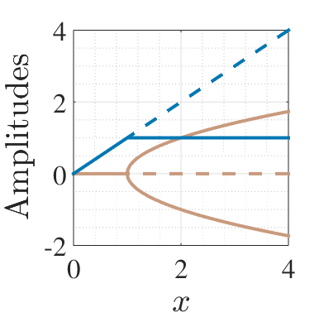
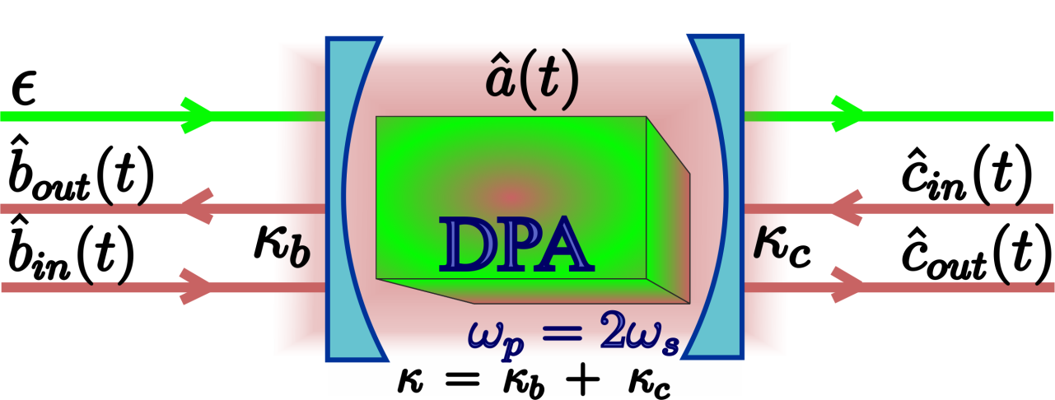
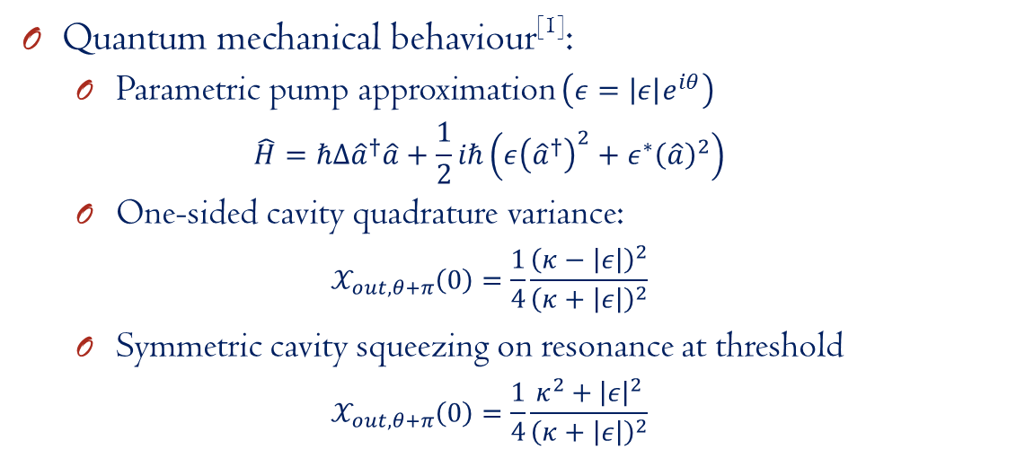
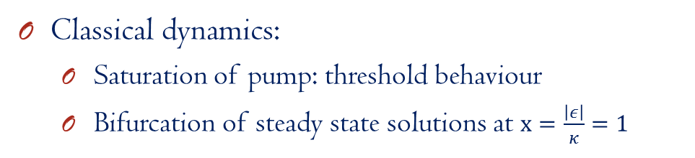
DPA dynamics & squeezing
Classical dynamics:
Saturation of pump: threshold behaviour
Bifurcation of steady state solutions at $x=\frac{\left|ε\right|}{κ}=1$
Quantum mechanical behaviour^{[1]}:
Parametric pump approximation $\left(ε=\left|ε\right|e^{iθ}\right)$
$$\hat{H}=ℏΔ{\hat{a}}^{†}\hat{a}+\frac{1}{2}iℏ\left(ε{\left({\hat{a}}^{†}\right)}^{2}+ε^{∗}{\left(\hat{a}\right)}^{2}\right)$$
One-sided cavity quadrature variance:
$$𝒳_{out,θ+π}\left(0\right)=\frac{1}{4}\frac{{\left(κ−\left|ε\right|\right)}^{2}}{{\left(κ+\left|ε\right|\right)}^{2}}$$
Symmetric cavity squeezing on resonance at threshold
$$𝒳_{out,θ+π}\left(0\right)=\frac{1}{4}\frac{κ^{2}+{\left|ε\right|}^{2}}{{\left(κ+\left|ε\right|\right)}^{2}}$$
^{[1]}M. J. Collett, C. W. Gardiner, PRA, 30:1386 (1984)

Slide 4
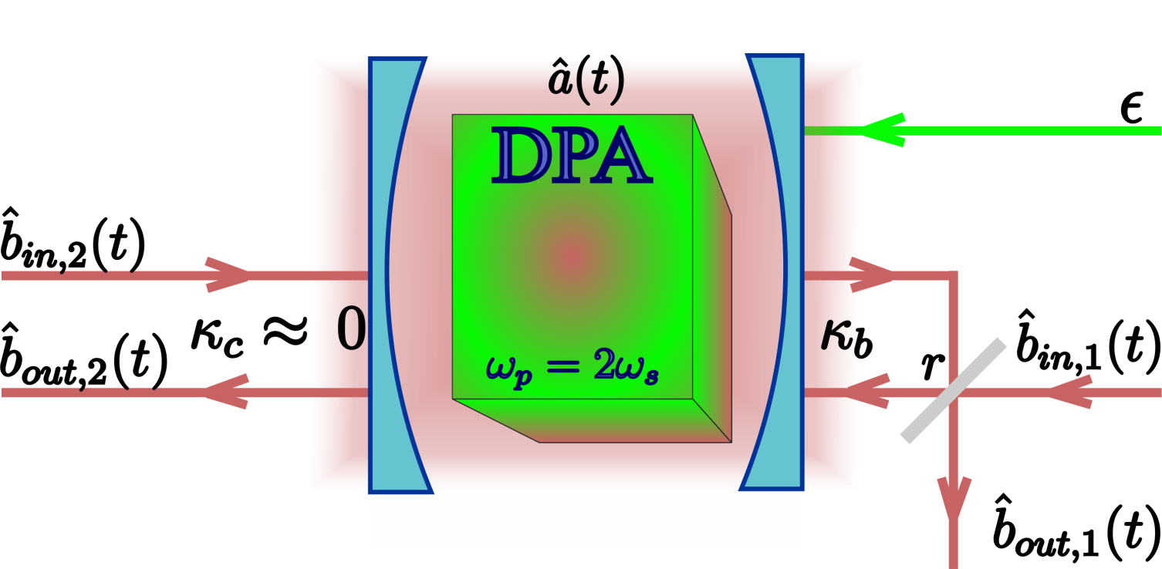
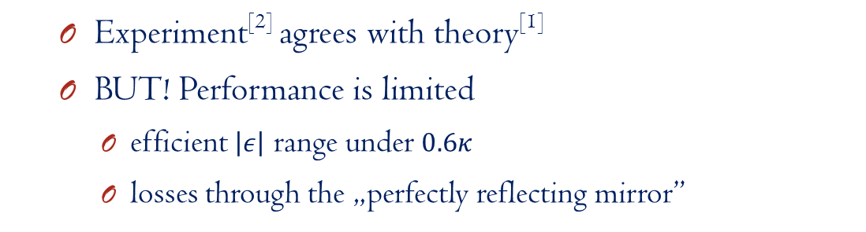
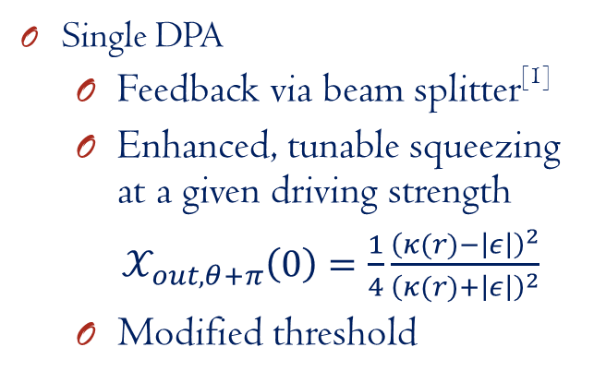
Coherent feedback with DPA
Single DPA
Feedback via beam splitter^{[1]}
Enhanced, tunable squeezing at a given driving strength
$𝒳_{out,θ+π}\left(0\right)=\frac{1}{4}\frac{{\left(κ(r)−\left|ε\right|\right)}^{2}}{{\left(κ(r)+\left|ε\right|\right)}^{2}}$
Modified threshold
Experiment^{[2]} agrees with theory^{[1]}
BUT! Performance is limited
efficient $\left|ε\right|$ range under $0.6κ$
losses through the „perfectly reflecting mirror”
^{[1]} J. E. Gough, S. Wildfeuer, PRA, 80:042107 (2009), ^{[2]}A. Furusawa’s group, IEEE Trans. Auto. Contr., 57:2045 (2012)

Slide 5
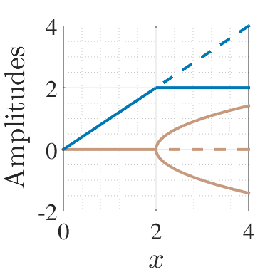
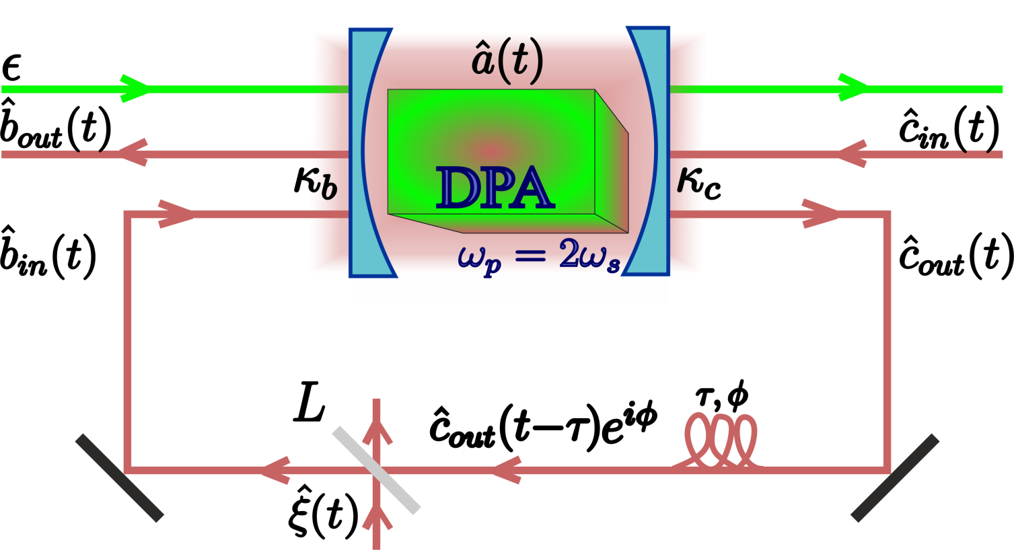
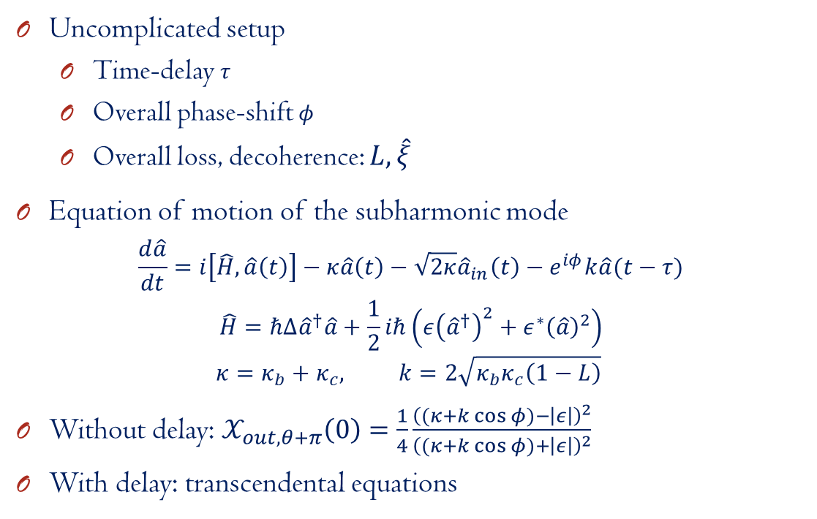
DPA with delayed coherent feedback
Uncomplicated setup
Time-delay $τ$
Overall phase-shift $φ$
Overall loss, decoherence: $L,\hat{ξ}$
Equation of motion of the subharmonic mode
$$\frac{d\hat{a}}{dt}=i\left[\hat{H},\hat{a}\left(t\right)\right]−κ\hat{a}\left(t\right)−\sqrt{2κ}{\hat{a}}_{in}\left(t\right)−e^{iφ}k\hat{a}(t−τ)$$
$$\hat{H}=ℏΔ{\hat{a}}^{†}\hat{a}+\frac{1}{2}iℏ\left(ε{\left({\hat{a}}^{†}\right)}^{2}+ε^{∗}{\left(\hat{a}\right)}^{2}\right)$$
$$κ=κ_{b}+κ_{c}, k=2\sqrt{κ_{b}κ_{c}\left(1−L\right)}$$
Without delay: $𝒳_{out,θ+π}\left(0\right)=\frac{1}{4}\frac{{\left((κ+k\cos{φ})−\left|ε\right|\right)}^{2}}{{\left((κ+k\cos{φ})+\left|ε\right|\right)}^{2}}$
With delay: transcendental equations

Slide 6
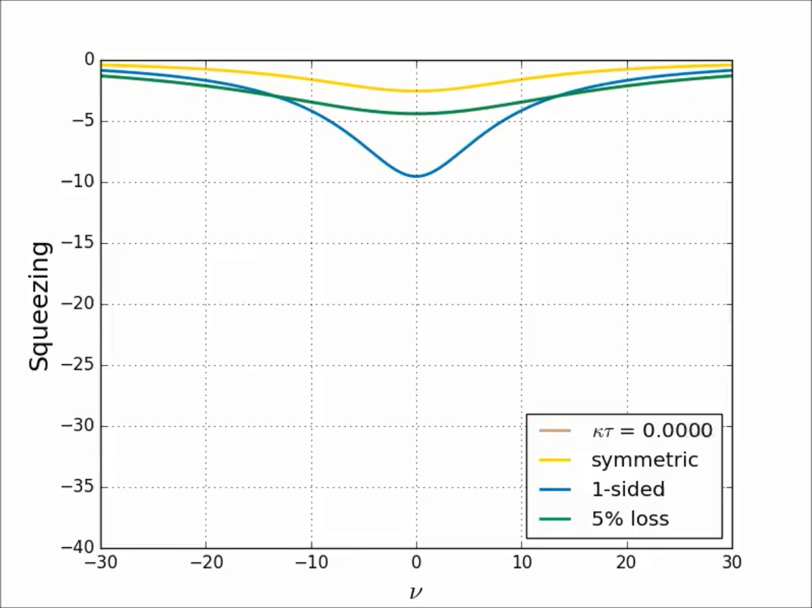
Squeezing spectra^{[1]}
^{[1]}M. J. Collett, C. W. Gardiner, PRA, 30:1386 (1984)

Slide 7
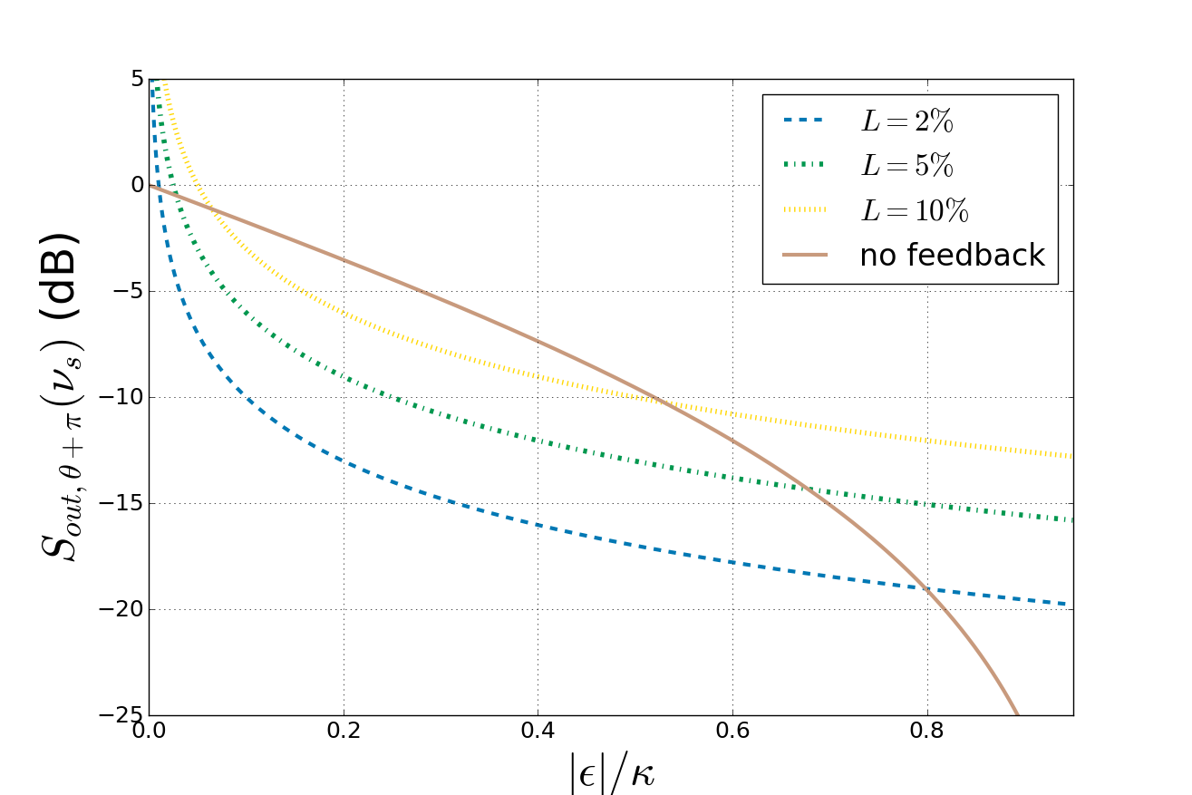

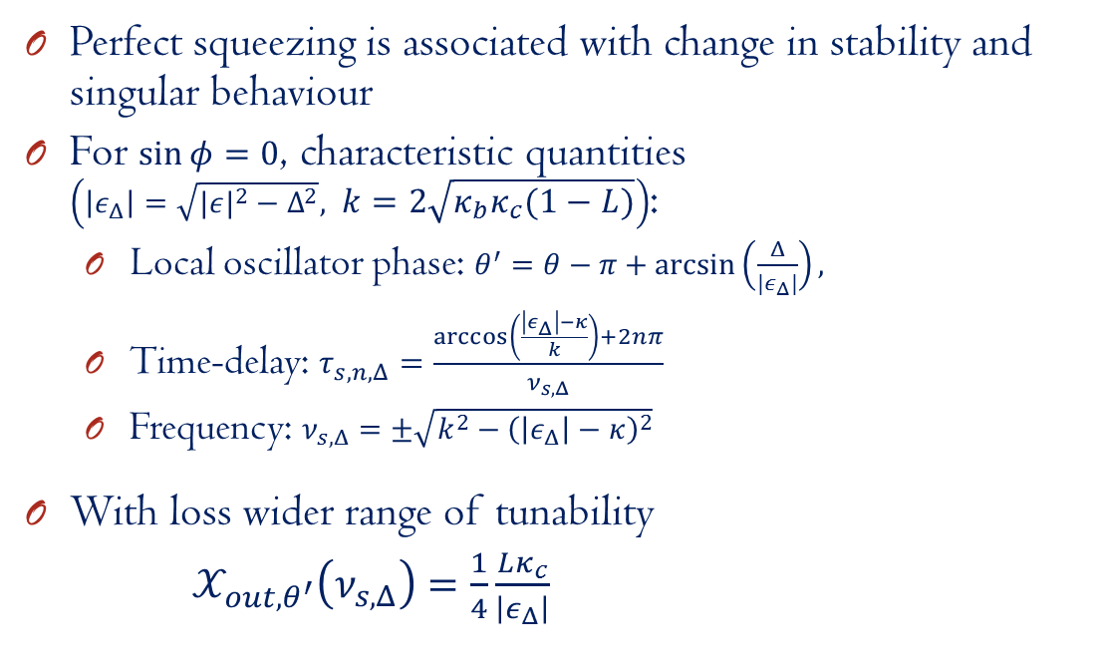
When do these peaks appear?
Perfect squeezing is associated with change in stability and singular behaviour
For $\sin{φ}=0$, characteristic quantities $\left(\left|ε_{Δ}\right|=\sqrt{|{ε|}^{2}−Δ^{2}}, k=2\sqrt{κ_{b}κ_{c}\left(1−L\right)}\right)$:
Local oscillator phase: $θ^{′}=θ−π+\arcsin\left(\frac{Δ}{{|ε}_{Δ}|}\right),$
Time-delay: $τ_{s,n,Δ}=\frac{\arccos\left(\frac{\left|ε_{Δ}\right|−κ}{k}\right)+2nπ}{ν_{s,Δ}}$
Frequency: $ν_{s,Δ}=±\sqrt{k^{2}−{\left(\left|ε_{Δ}\right|−κ\right)}^{2}}$
With loss wider range of tunability
$𝒳_{out,θ^{′}}\left(ν_{s,Δ}\right)=\frac{1}{4}\frac{Lκ_{c}}{\left|ε_{Δ}\right|}$

Slide 8
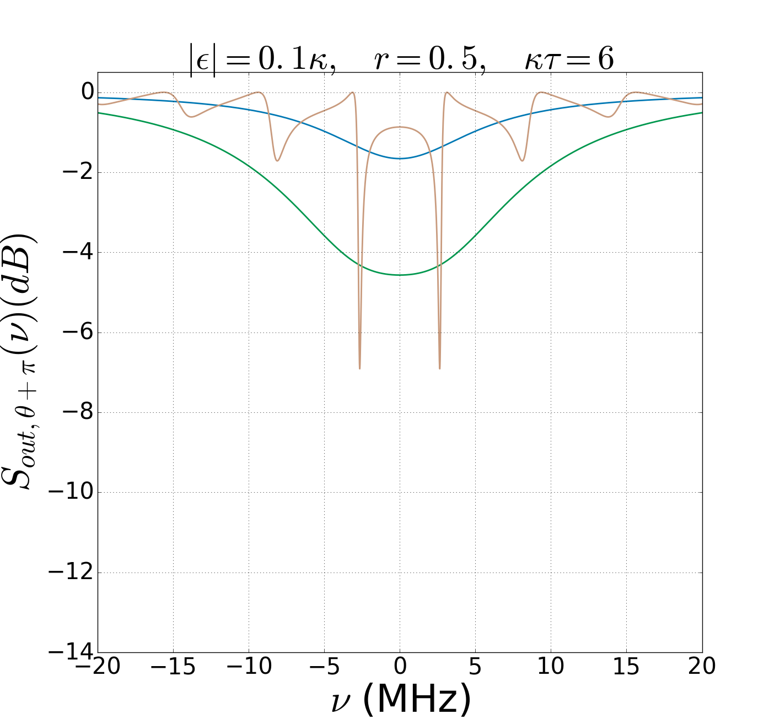
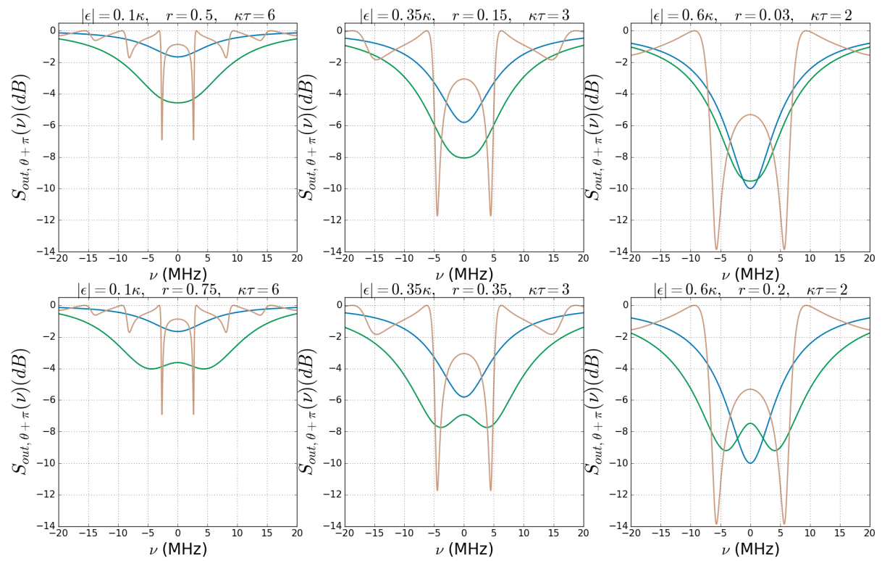
Comparison with previous results^{[1,2]}
with BS
feedback
without
feedback
with delayed feedback
without
feedback
with BS
feedback
without
feedback
with BS
feedback
with delayed feedback
with delayed feedback
^{[1]} M. J. Collett, C. W. Gardiner, PRA, 30:1386 (1984), ^{2]}A. Furusawa’s group, IEEE Trans. Auto. Contr., 57:2045 (2012)

Slide 9
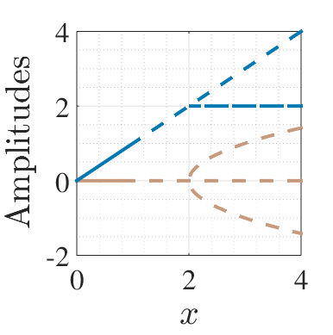
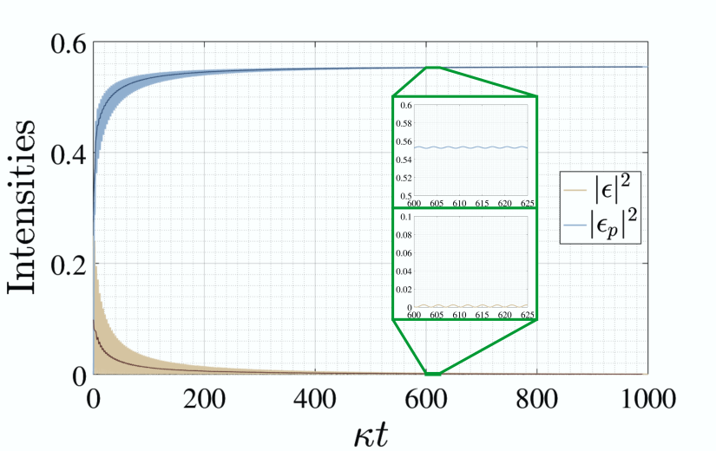
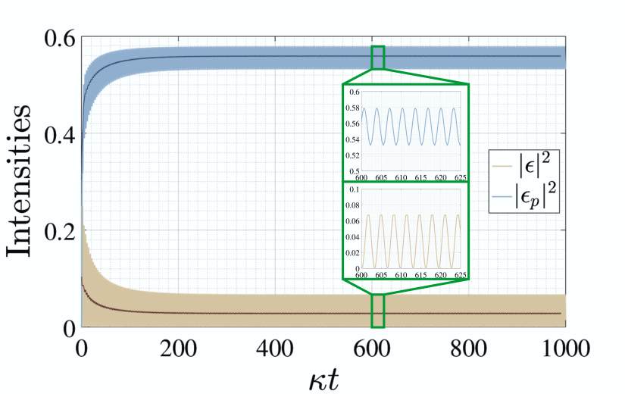
Classical analysis
Time-delay: Changing stability of steady state solutions
Hopf bifurcation
Imaginary eigenvalue becomes the frequency of persistent oscillations

Slide 10
Summary
Coherent feedback: backaction-free way of enhancing useful quantum properties
Time-delay: tunable changes in the stability range
In a time-delayed one-loop setup with a DPA, dramatically enhanced squeezing was found
Enhancement even compared to previous feedback setups
Result of the changing dynamics of the system
Loss in the feedback loop decreases the degree of squeezing, but also provides higher tunability

Slide 11

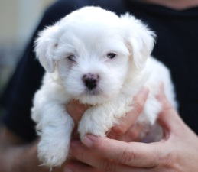

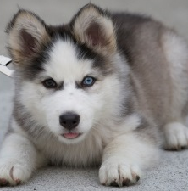
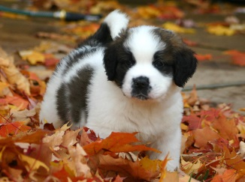


Thank you for Your
1
2
attention!
3
4
5
6
7
8

Slide 12
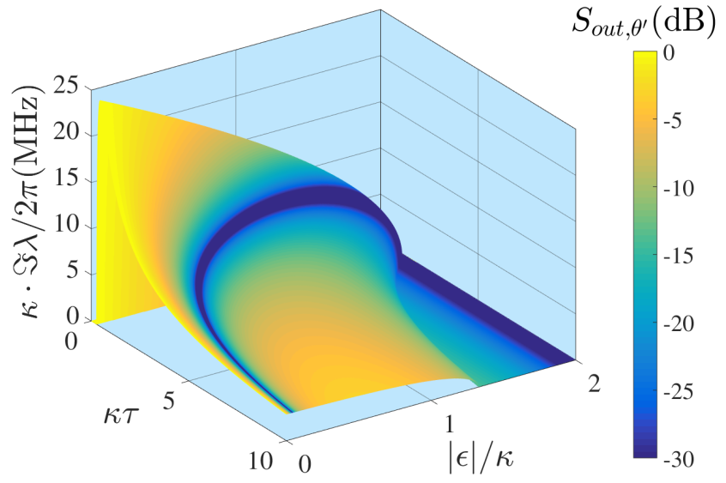
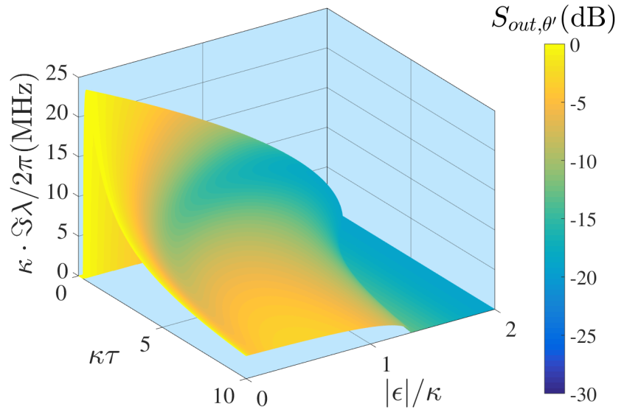
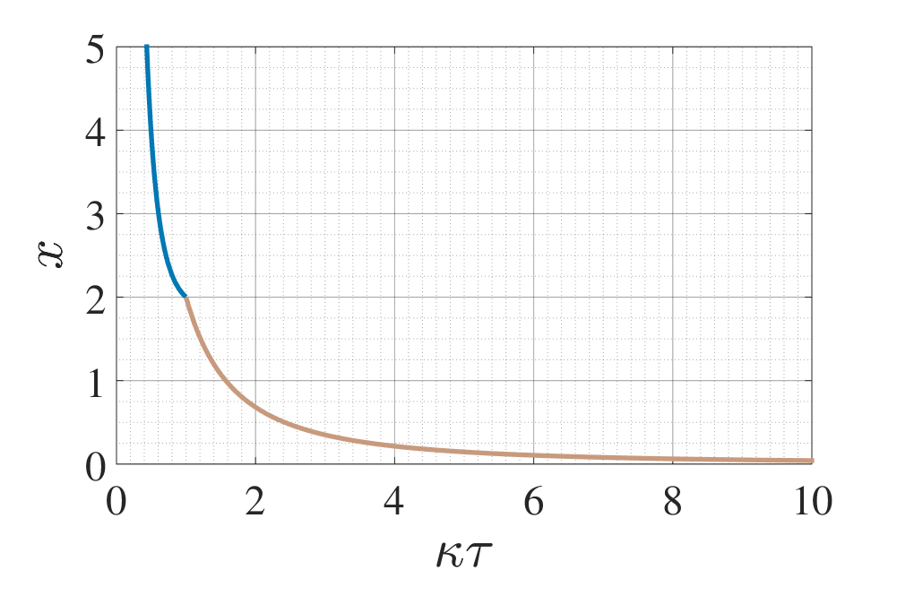
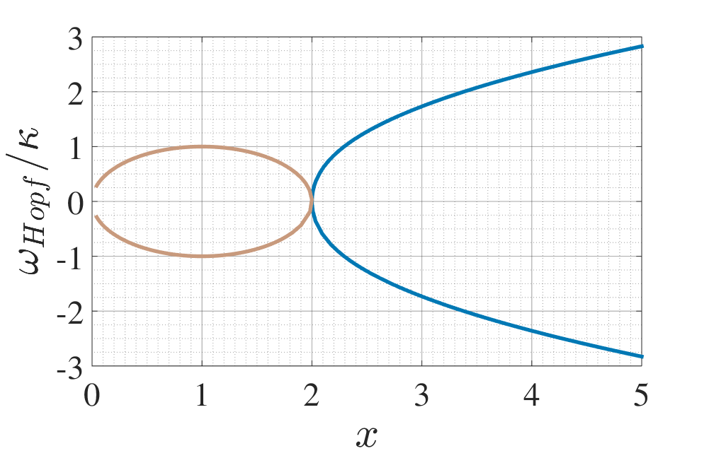
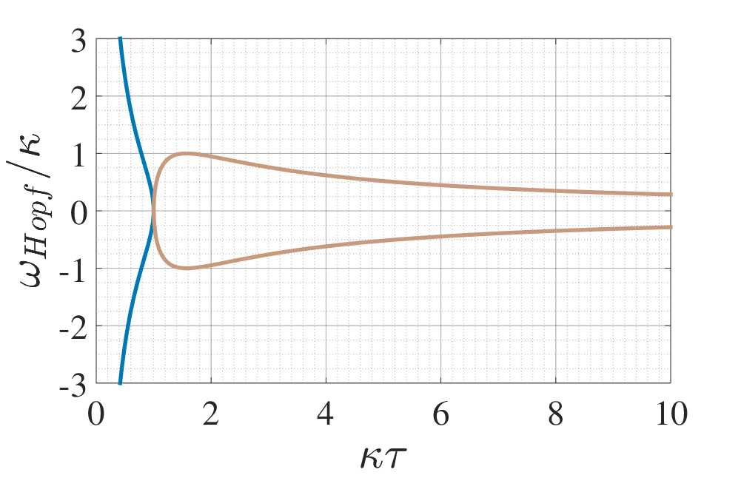
Tunability
$$0≤ν_{s}≤\sqrt{\left|ε\right|\left(2κ−\left|ε\right|\right)},0≤\left|ε\right|≤\left|κ+ke^{iφ}\right|$$

Slide 13
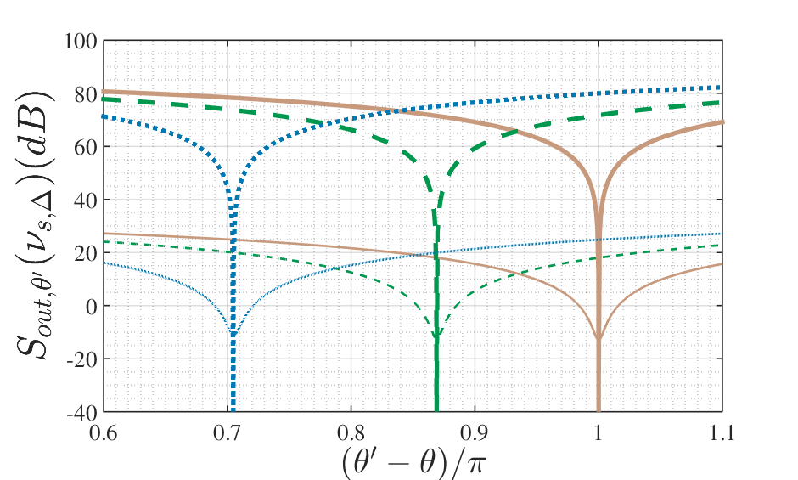
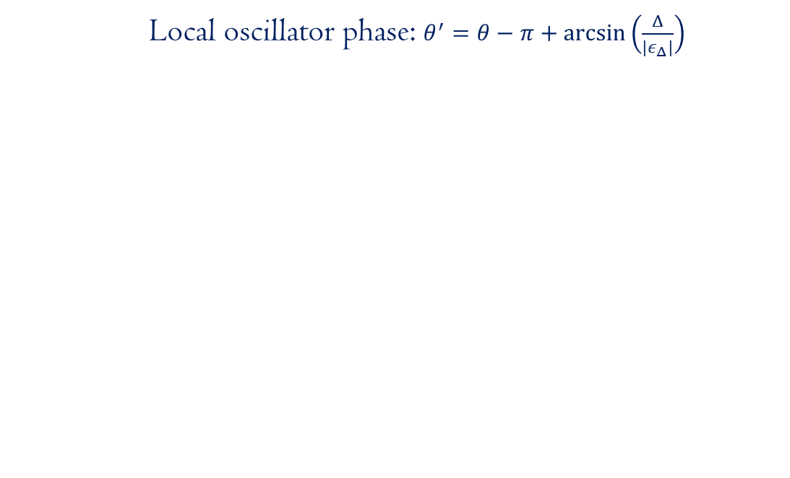
Detuning and quadrature angle
Local oscillator phase: $θ^{′}=θ−π+\arcsin\left(\frac{Δ}{{|ε}_{Δ}|}\right)$

Slide 14
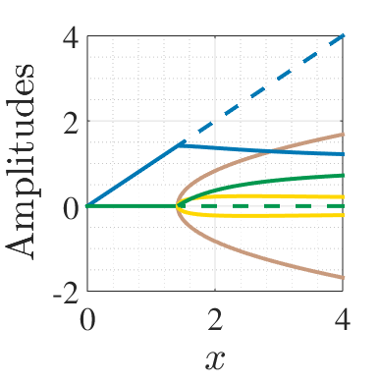
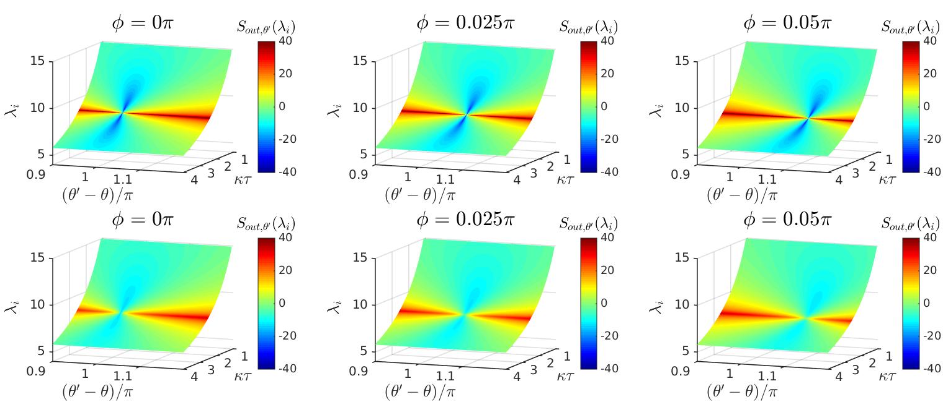
Effects of the phase shift

Slide 15
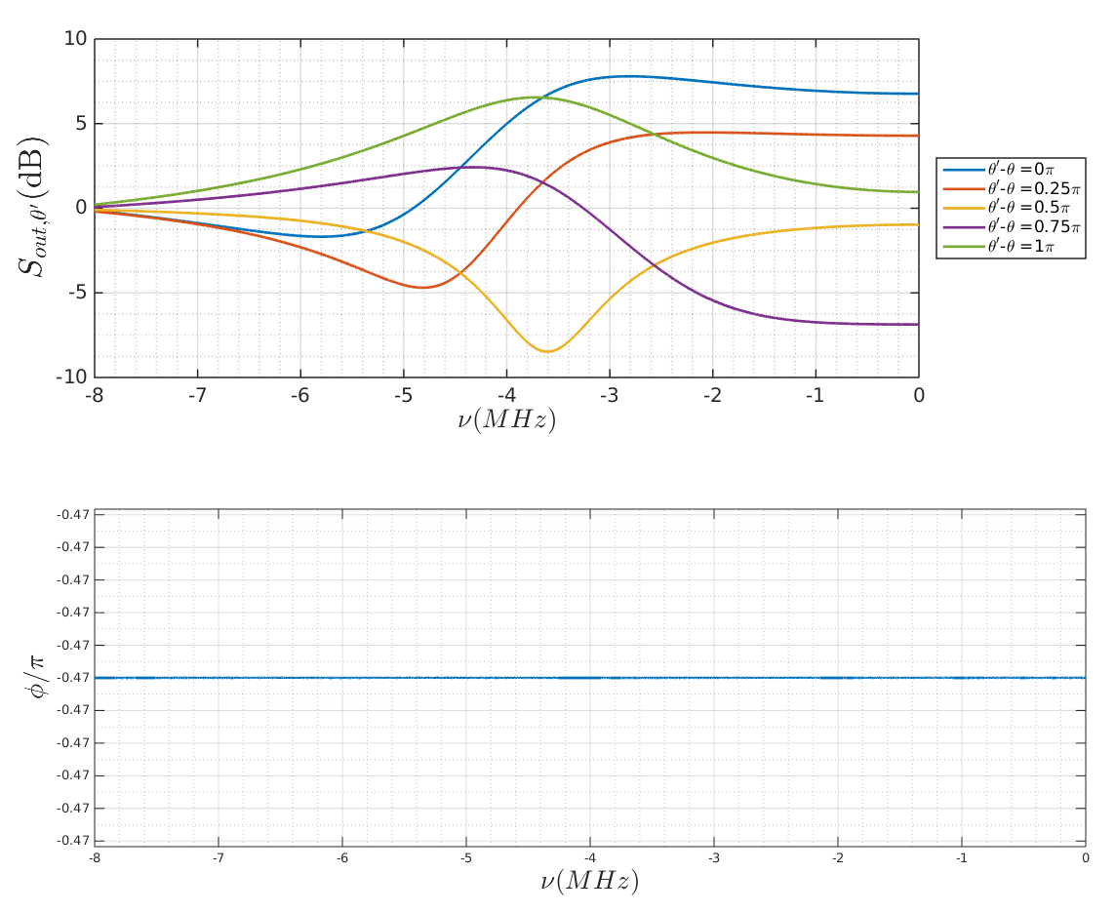
Gravitational wave detection

Slide 16
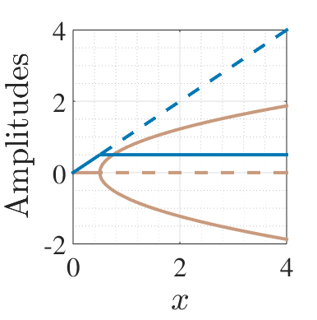
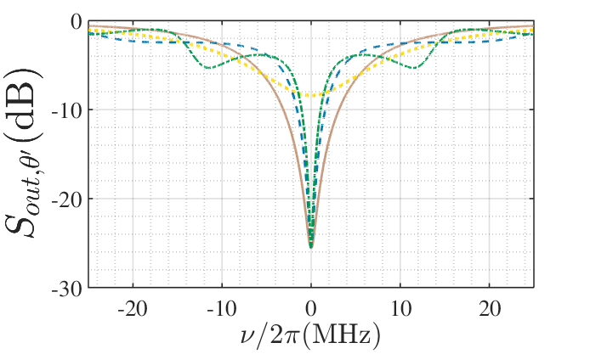
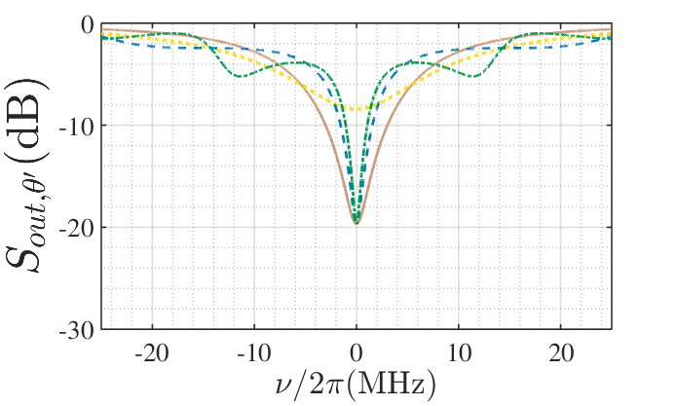
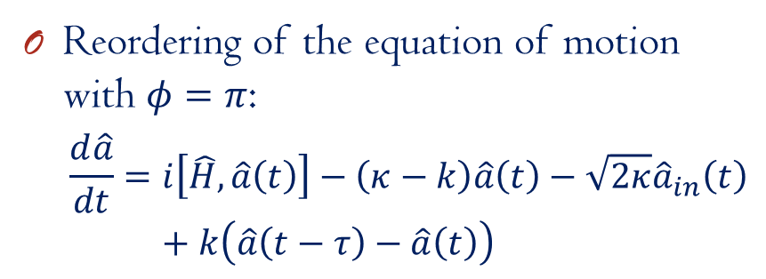
Pyragas-type feedback^{[1,2]}
Reordering of the equation of motion with $φ=π$:
$$\frac{d\hat{a}}{dt}=i\left[\hat{H},\hat{a}\left(t\right)\right]−\left(κ−k\right)\hat{a}\left(t\right)−\sqrt{2κ}{\hat{a}}_{in}\left(t\right)+k\left(\hat{a}\left(t−τ\right)−\hat{a}\left(t\right)\right)$$
^{[1]}K. Pyragas, PLA, 170:421 (1992), ^{[2]}A. L. Grimsmo, A. S. Parkins, B. S. Skagerstam, NJP 16:065004 (2014),

Slide 17
More previous studies
Plant and controller system
Controller: two-mode squeezer
C. Bian, G. Zhang, H. W. J. Lee, Int. J. Cont. 85:1865 (2012)
2 OPOs coupled in a feedback loop with a phase difference
H. Mabuchi’s group, Opt. Express 21:1 (2013)
Trapped modes in a linear system
Z. Shi, H. I. Nurdin, arXiv: 1510.08942
Delayed feedback for discreet quantum information: A. Knorr’s group

